Slide 1

Software Engineering
Designing with patterns
Harald Drillenburg
Year 2 2nd term

Slide 2

Course structure
Principles of Software Engineering
The zen of project planning
Developing under architecture
Designing with patterns
Testing and continuous integration
Test Driven Development
Architecture in Agile projects
Year 2 2nd term

Slide 3



Questions during class!
Jaar 2 Kwartaal 1

Slide 4
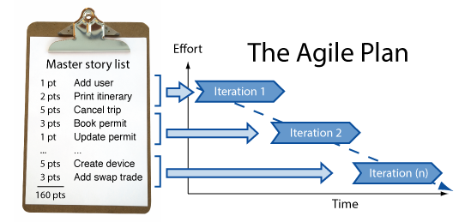

Discussion: project plan for EPD
Year 2 2nd term

Slide 5
Design Patterns
General solutions to specific problems
Making software much more adaptable
Most well-known: GoF
But there are many more:
  Technology-specific patterns
  Pattern libraries
  Compound patterns
  Anti-patterns
  Analysis patterns
Year 2 2nd term

Slide 6

Classical patterns
Observer
Strategy
Composite
Decorator
Factory
Singleton
Command
Iterator
…..
Year 2 2nd term

Slide 7
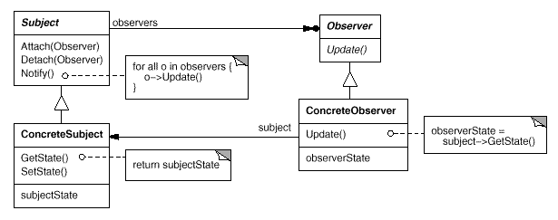
Observer pattern
Year 2 2nd term

Slide 8
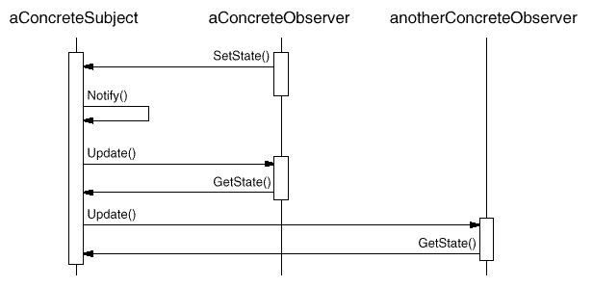
Observer pattern
Year 2 2nd term

Slide 9
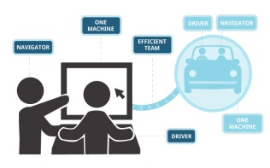
Looking for proof of the pudding
Define the interfaces according to the pattern
Define a class for the thing to be observed. Start with a simple class
  Persons can change things
  Person can change his Address
Define a class observing it
  The Municipality would be interested
Add the interfaces to the class definitions
Generate the methods
Implement the methods to make them work
Use output to the console to test
Year 2 2nd term

Slide 10

Eat the pudding
Define another class which would not be related to the previous one, but would be observable
  Airplanes can change their altitude
Have it implement the interface and test it again
Define a class which would observe both, but is not related to any of them
  LittleGreyMan would do so
Have it implement the interface and test again
Year 2 2nd term

Slide 11
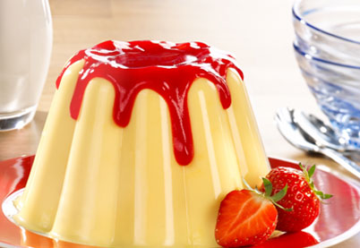
The pudding
Year 2 2nd term

Slide 12
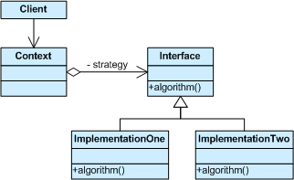
Strategy pattern
Year 2 2nd term

Slide 13
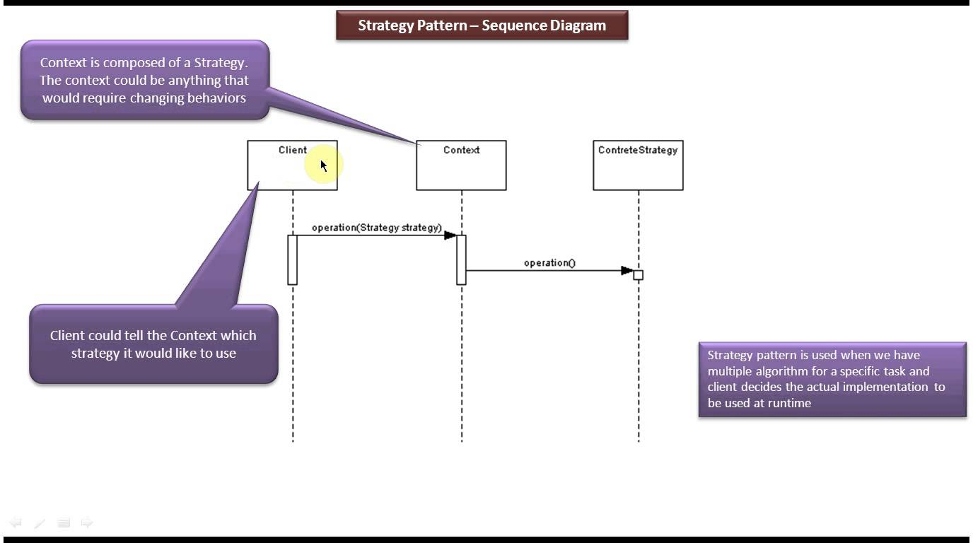
Strategy pattern
Year 2 2nd term

Slide 14
Looking for proof of the pudding
Define the interface according to the pattern
Define a class for the Strategy. Start with a simple class
  SimpleLotteryNumberStrategy will calculate the ‘winning’ lottery number by getting a random number
Define a class using this
  GamblingAddict wants to get the numbers
Add the interface to the class definition
Generate the methods
Implement the methods to make them work
Use output to the console to test
Year 2 2nd term

Slide 15
Eat the pudding
Define another class with the same purpose, but using another algorithm
  DateLotteryNumberStrategy will use the current datetime to generate a ‘more fitting’ number
Implement the interface
Change the using class to use the new strategy instead
Run the test again
Year 2 2nd term

Slide 16

Assignment: eat the pudding
Year 2 2nd term

Slide 17
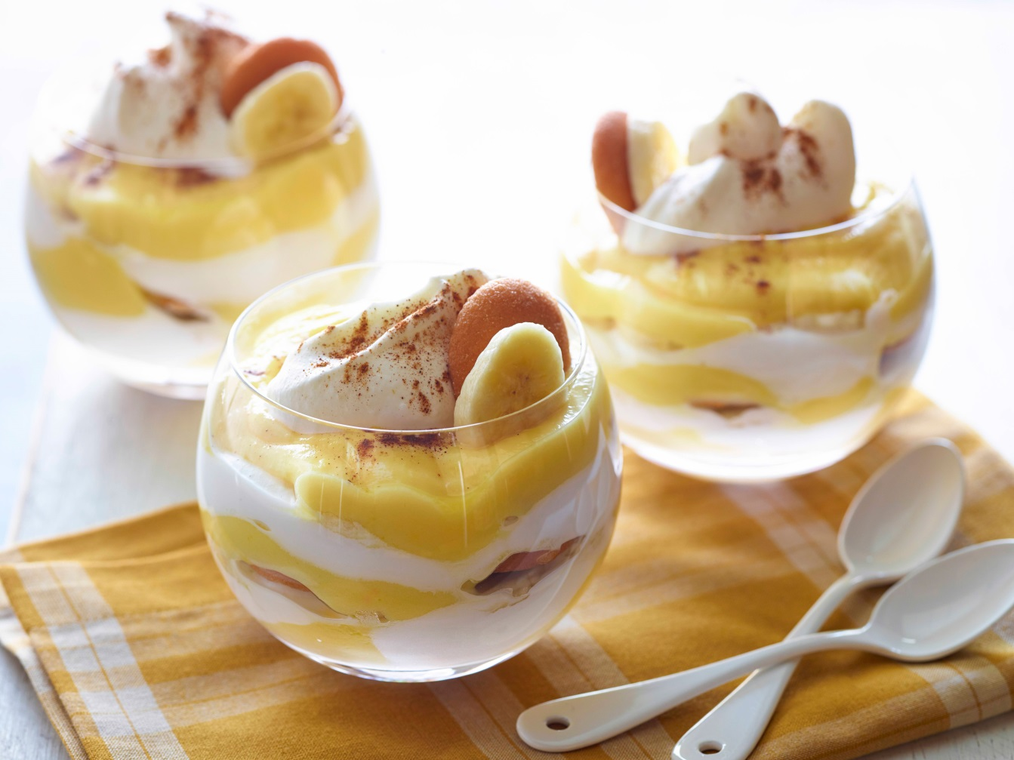
Show me the pudding!
Year 2 2nd term

Slide 18
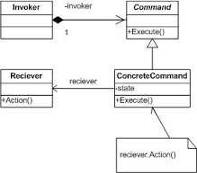
Command pattern
Year 2 2nd term

Slide 19
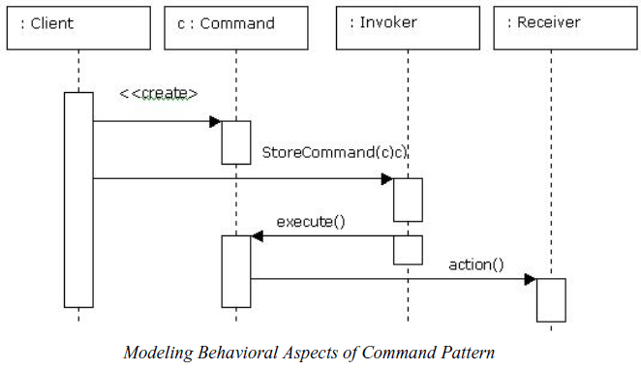
Command pattern
Year 2 2nd term

Slide 20
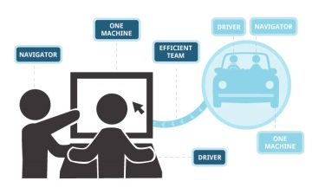
Looking for proof of the pudding
Interface: ICommand
  Public void execute();
Concrete commands: shutdown, giveError, proceed
Receiver: Engine
Command to be added later: playMusic, playVideo
Command to be added after that: proceed(ICommand)
Year 2 2nd term

Slide 21
Assignment: eat the pudding
Year 2 2nd term

Slide 22
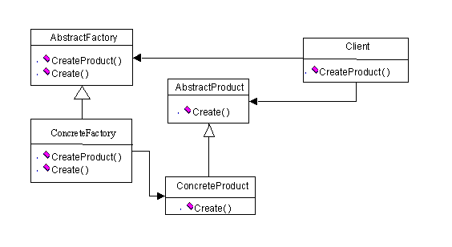
Abstract Factory pattern
Year 2 2nd term

Slide 23
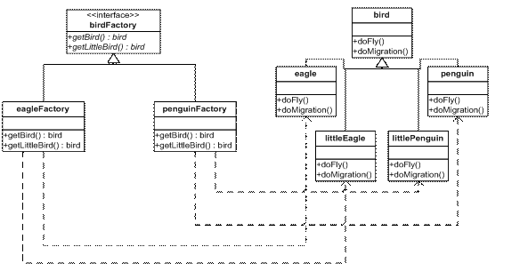
Abstract Factory pattern
Year 2 2nd term

Slide 24
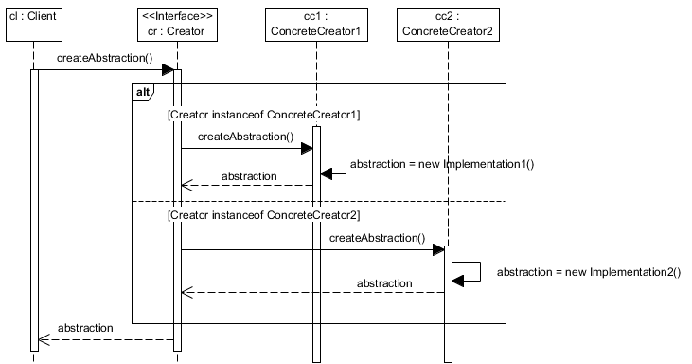
Abstract Factory pattern
Year 2 2nd term

Slide 25
Assignment: eat the pudding
Year 2 2nd term

Slide 26
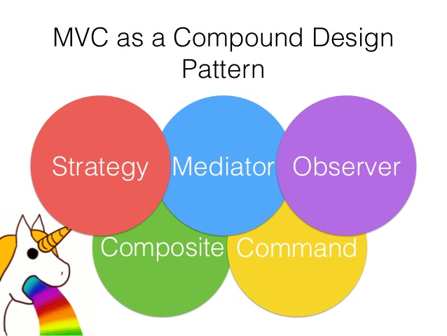
Compound patterns
Year 2 2nd term

Slide 27
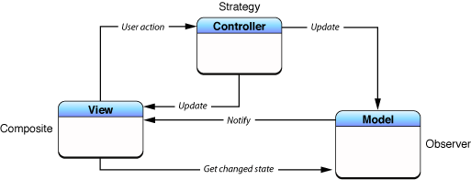
Model View Controller pattern
Year 2 2nd term

Slide 28
Assignment
Create a PoC where there’s an Observable, an Observer which is also an Observable, and a final Observer
Create a PoC for a compound pattern which:
  Uses the Abstract Factory to:
  Create Strategy objects which:
  Use different implementations for sorting an Array of objects
    (Actually implementing the sorting is optional!)
Create a PoC where a Factory generates Command objects which in turn are sent to an Observable. The Observable determines when it changes according to the outcome of the command
  Can you also put in the Strategy here?
Year 2 2nd term

Slide 29
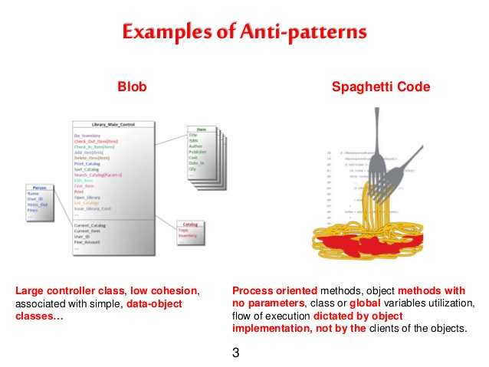
Antipatterns
The Blob
Lava Flow
Functional Decomposition
Poltergeists
Golden Hammer
Spaghetti Code
Stovepipes
….
Year 2 2nd term

Slide 30
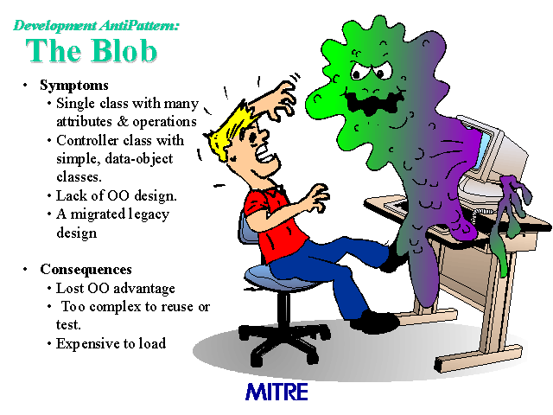
Antipattern: The Blob
Year 2 2nd term

Slide 31
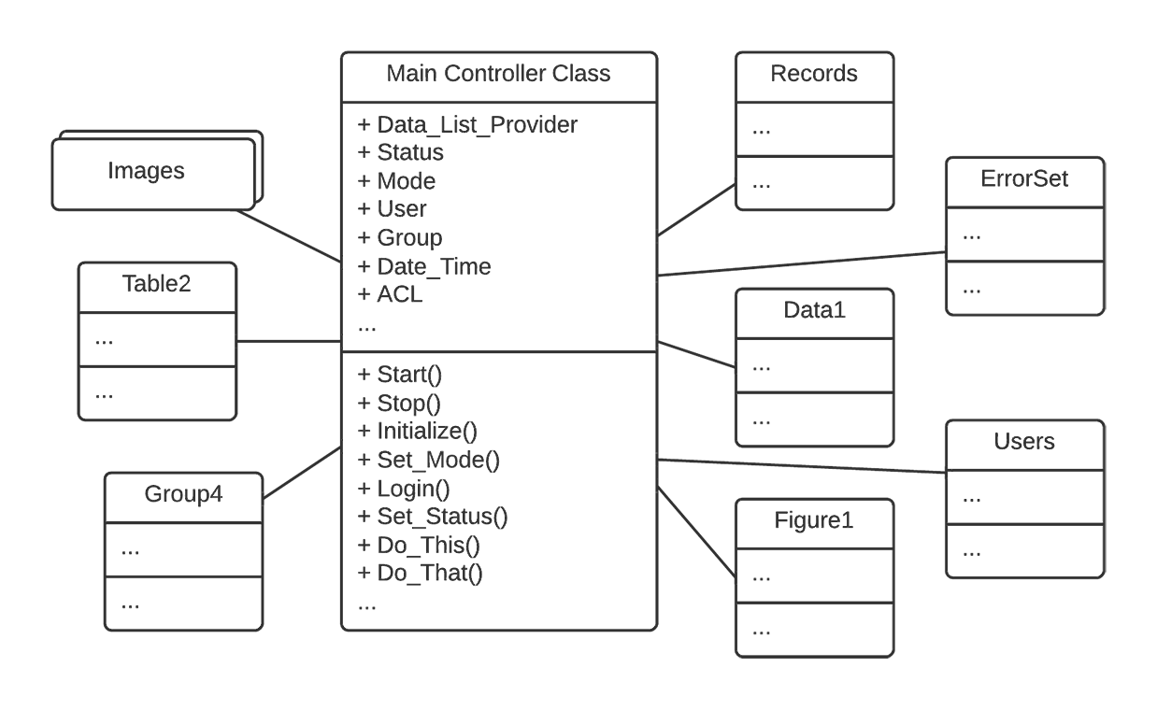
Antipattern: The Blob
Year 2 2nd term

Slide 32
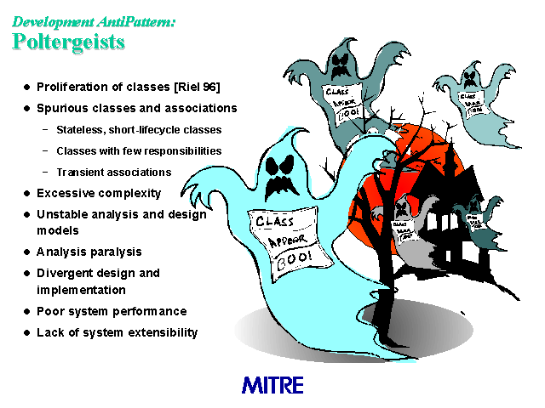
Antipattern: The Poltergeists
Year 2 2nd term

Slide 33
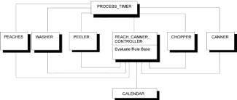
Antipattern: The Poltergeists
Year 2 2nd term

Slide 34
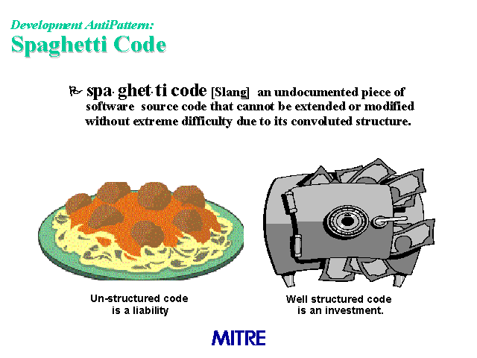
Antipattern: Spaghetti Code
Year 2 2nd term

Slide 35
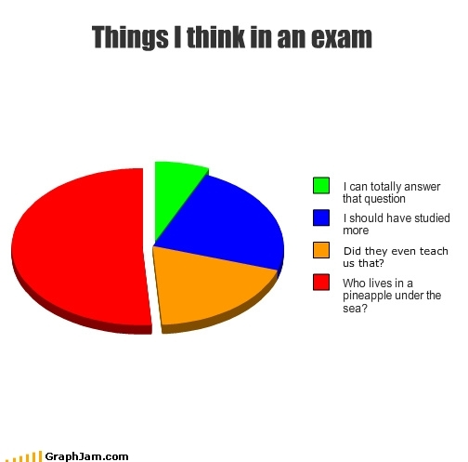
Assignment
Take the course description from blackboard
Look carefully at the grading criteria
Create exam questions with answers which you think would be good examples for the real exam
Send those to the teacher
  You are going to create your own mock exams during this course!
  Or should I just reuse some questions? Tempting…..
Year 2 2nd term

Slide 36
Assignment
Implement a few short examples of the anti-patterns discussed
  Kind of PoC’s themselves….
Year 2 2nd term

Slide 37

Homework
Read Chapter 1-5 from the textbook
Do the exercises intermingled in the book
Finish the exercises in these sheets
  Yes, they are way too many to finish during this class!
Year 2 2nd term

